Slide 1


Introduction to Machine Learning: Session 1
Nadia Kennar, Research Associate at the UK Data Service (Cathie Marsh Institute, UoM)
Copyright © 2022 University of Manchester, Cathie Marshe Institute, UK Data Service.

Slide 2
Interaction
During this workshop you can use the Zoom chat for technical questions or comments (to chat with the facilitato).
If you want to ask questions in relation to the content of this talk, then you can use the Zoom Q+A function.

Slide 3
Can you hear us?
?

Slide 4
Troubleshooting audio problems
Check your speaker/headset is plugged in / volume is on.
Click on audio to change to listening via phone
We are recording this webinar and will post it on YouTube (https://www.youtube.com/user/UKDATASERVICE)
This workshop is being run live on YouTube.
Live transcription has also been enabled.

Slide 5
Session 1: October 24th
Context:
What is machine learning?
What is a model?
Machine learning methods
How is ML different from classic statistics
7 Steps to Machine Learning?

Slide 6
Session 2: October 26th
Exploring a specific unsupervised method, clustering
Centroid based: specifically, k-means algorithm
Hierarchical-based: divisive (top-down) and agglomerative (bottom-up)

Slide 7
Session 3: November 2nd
Live Code Demo
Using a dataset to explore different clustering methods
First hour in Python
Second hour in R

Slide 8
What is Machine Learning ?
Machine Learning is a subfield of artificial intelligence (AI)
i.e. the capability of a machine to imitate intelligent human behaviour
” the field of study that gives computers the ability to learn without explicitly being programmed.”
Arthur Samual, 1950

Slide 9
Functions of a Machine Learning System
Descriptive: uses the data to explain what happened
Predictive: the system use the data to predict what will happen
Prescriptive: the system will use the data to make suggestions about what action to take.
Credit: T.Molone, D.Russ, R.Laubacher

Slide 10
Why is machine learning important?
Increase in volume and variety of data
The access and affordability of computational power
Mitigate risks and improve overall quality of life

Slide 11
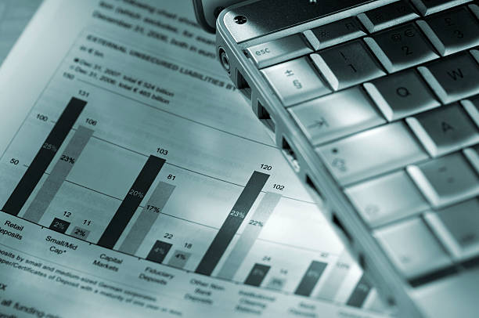



Why is machine learning important?

Slide 12
Machine Learning vs Classic Statistics
 | ML | Statistics
Approach | Data driven (limit assumptions) | Algorithmic model
Driver | Fitting Data | Math, theory
Focus | Predictive Accuracy | Hypothesis Testing
Inference | Predictions | Parameter Estimation

Slide 13
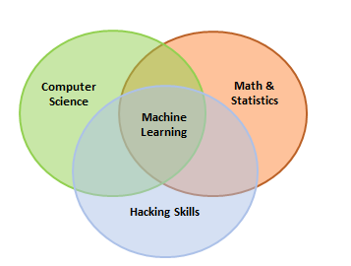
The ‘gray area’
Regression

Slide 14
Machine Learning Methods
Supervised Learning
Unsupervised Learning

Slide 15
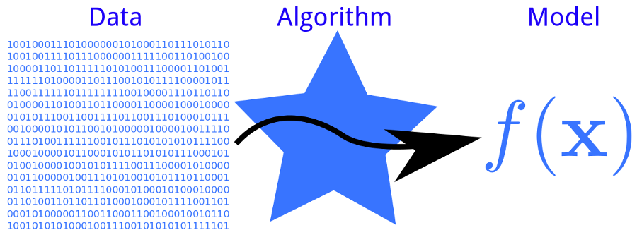
Model vs Algorithm?

Slide 16
How does a Machine Learning Algorithm Work ?
A Decision Process = the steps that takes in the data and guesses what kind of pattern your algorithm is looking to find.
A Loss/Error Function = measure how good the guess was by comparing it other examples
A Model Optimization Process = A method in which the algorithm looks at the miss and then updates the decision process

Slide 17

More about ‘models’
Inductive nature
Sample size
Inductive bias and generalisation

Slide 18

What is Supervised Learning?
Supervise = “observe and direct the execution of (a task or activity)”
How do you supervise a machine learning model?
“Teach the model”
Load the model with knowledge then have it predict future instances

Slide 19
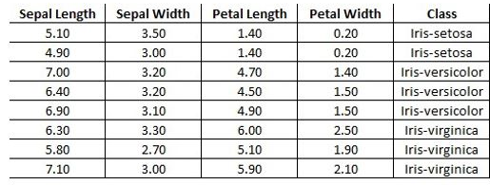
Continued…
We teach the model by training it with a labelled dataset
Features
Attributes

Slide 20
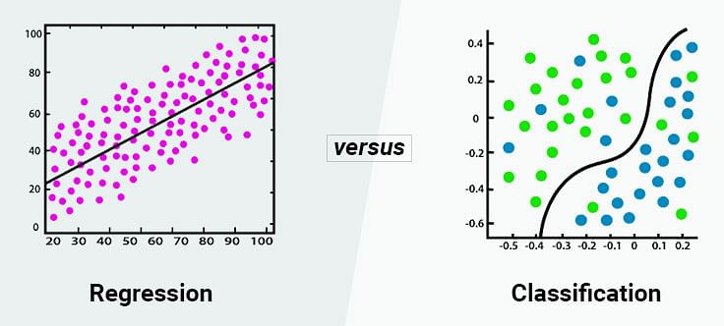
Continued
There are two types of supervised learning
i.e. predicting if sepal length increase does sepal width also increase
i.e. predicting class against sepal width

Slide 21
Supervised Algorithm Examples
Classification | Regression
Decision Tree | Simple linear regression
Random Forecast | Multiple Linear regression
K-Nearest Neighbor | Polynomial regression

Slide 22
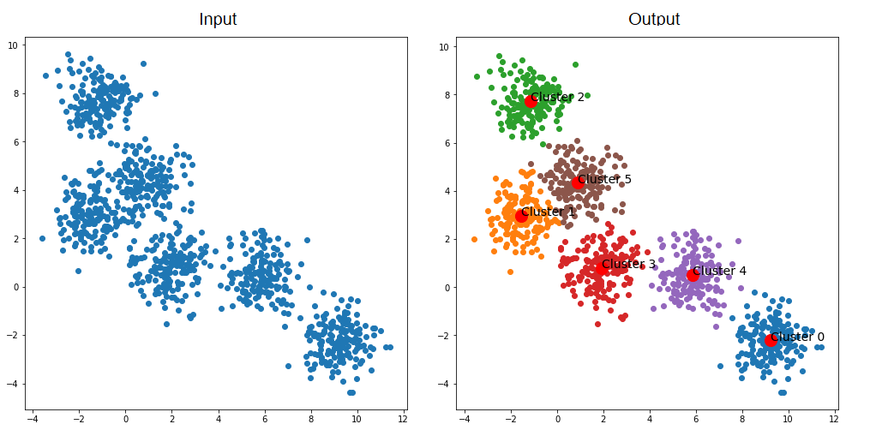
What is unsupervised learning?
We do not supervise the model but instead let the model work on its own to discover information that may not be visible

Slide 23
Unsupervised Algorithm Examples
Classification
Clustering | Association | Dimensionality Rediction
K-Means | Apriori | Principle component analysis
Hierarchical | Eclat | Singular Value Decomposition
Probabilistic | FP-Growth | Autoencoders

Slide 24
Other Machine Learning Methods
Semi-supervised learning
Reinforcement Learning
Deep Learning

Slide 25
7 Steps of Machine Learning
Collect Data
Data Preparation
Choosing a model
Training
Evaluation
Parameter Tuning
Prediction
Credit: Yufeng G, 2017

Slide 26
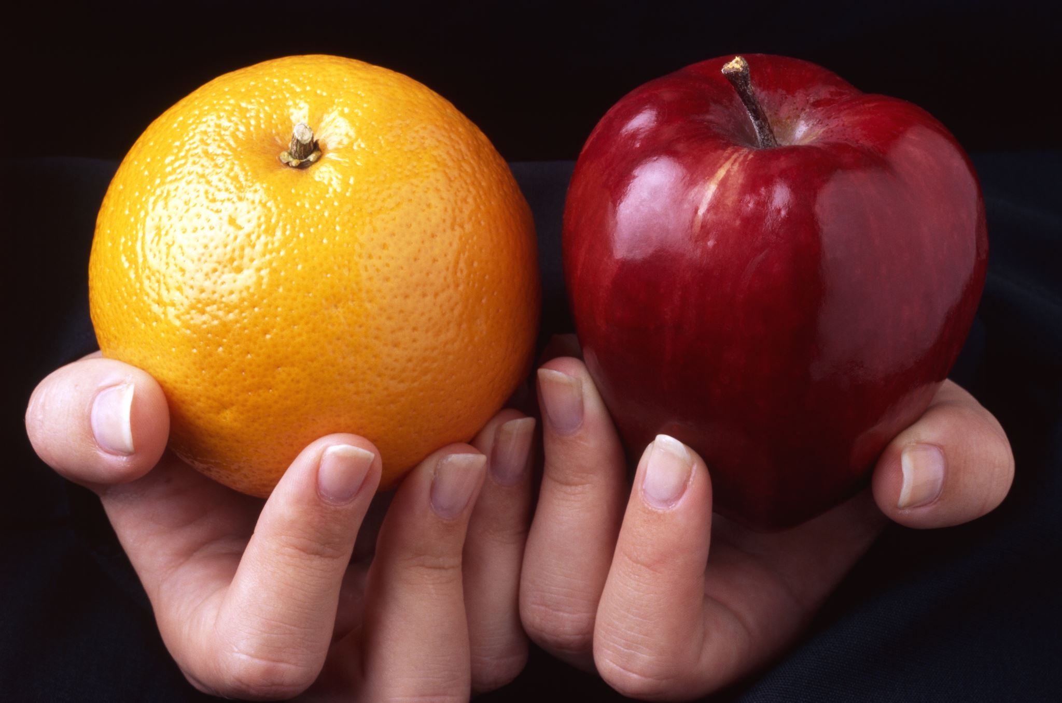
Case Study:
Let’s say we have been asked to create a system that answers the question of whether a food item can be classed as an ‘apple’ or as an ‘orange’

Slide 27
Step 1 – Gather data
Colour | Shape | Apple or Orange
Green | Round | Apple
Orange | Round | Orange

Slide 28
Step 2 – Prepare Data
Randomise the order of your data
Examine for any skewness
Split data into two parts
~80% would be used for training
~20% would be used for the evaluation process

Slide 29
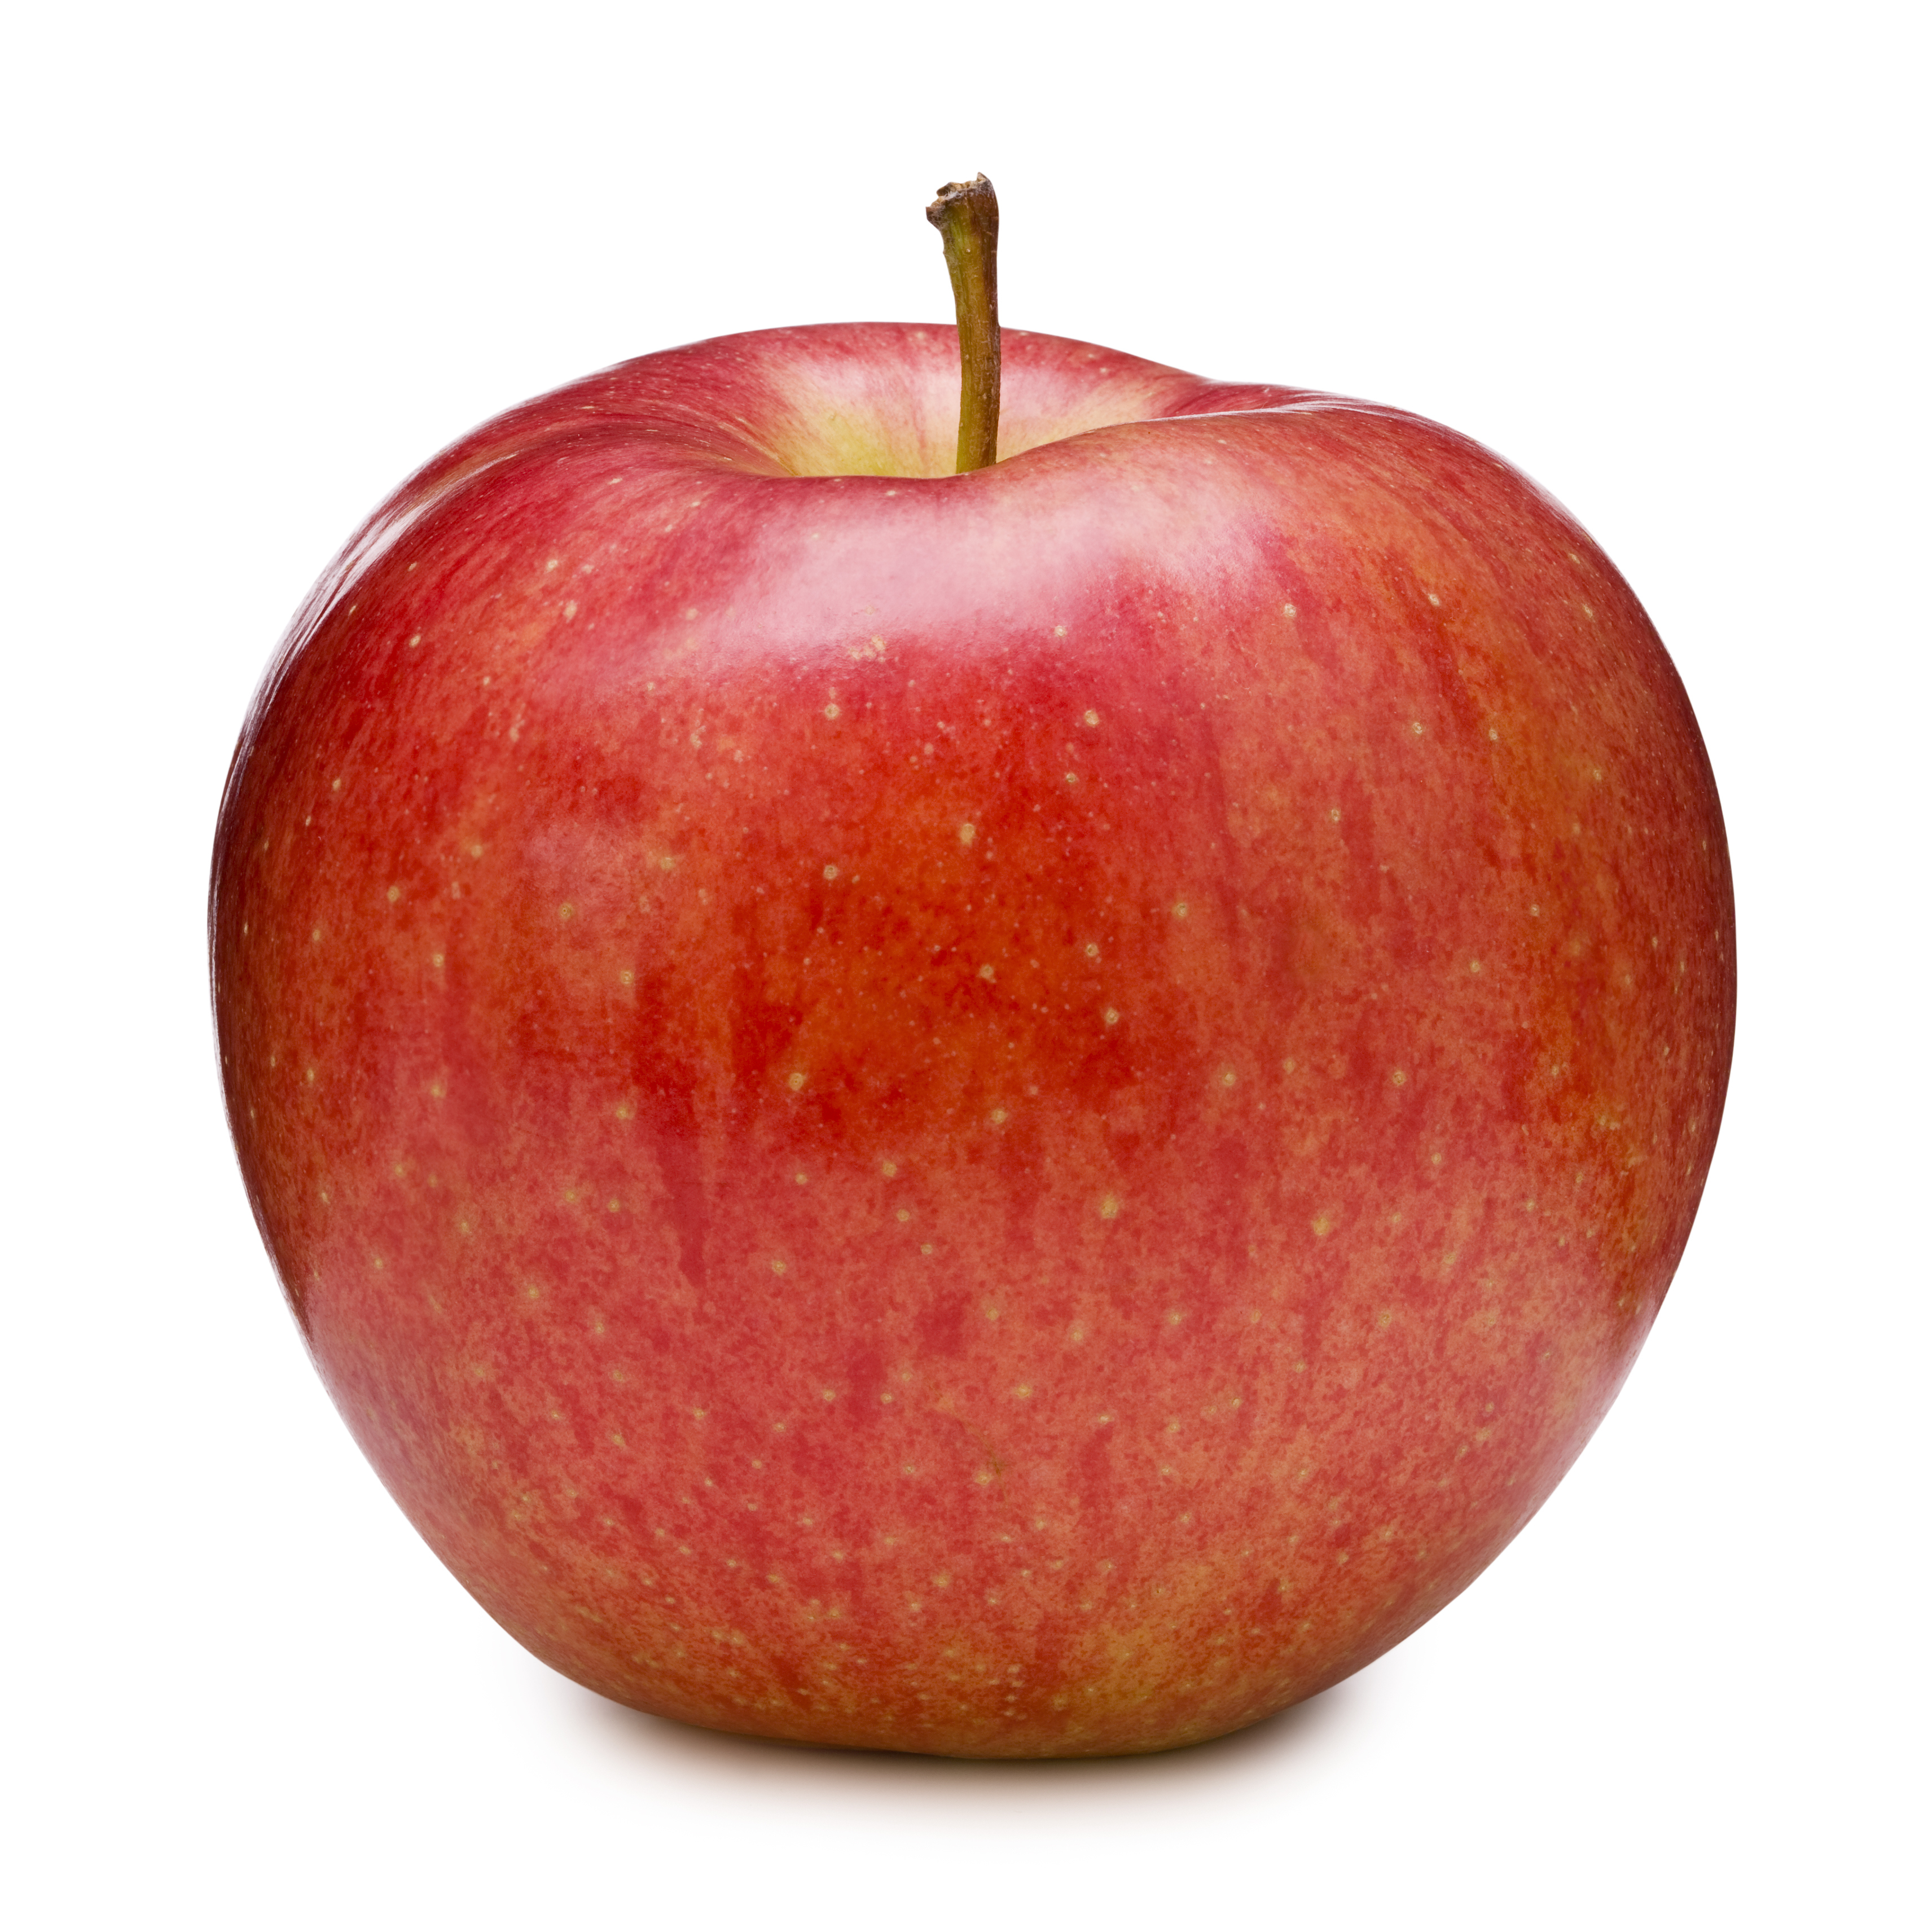
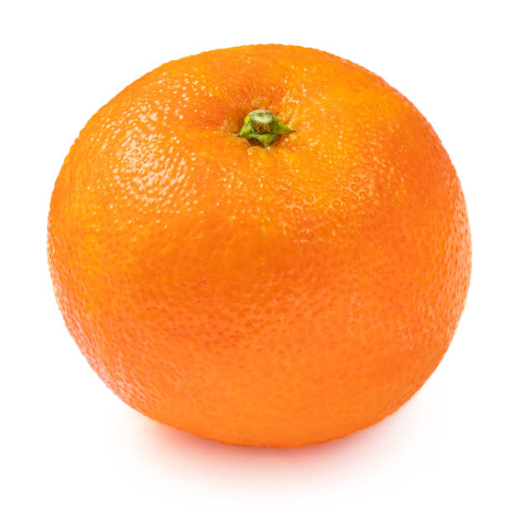

Step 3 – Choosing a Model
The colour red = Apple
The colour orange = Orange

Slide 30
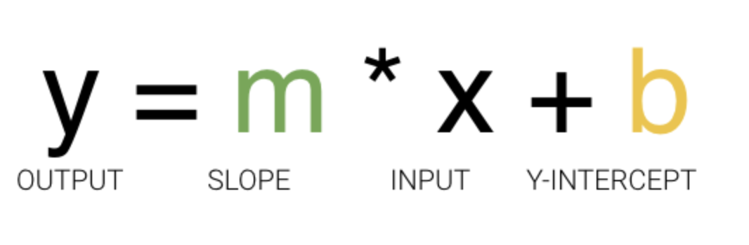
Step 4 – Training
The colour red = Apple
The colour orange = Orange

Slide 31
And again…
A Decision Process = the steps that takes in the data and guesses what kind of pattern your algorithm is looking to find.
A Loss/Error Function = measure how good the guess was by comparing it other examples
A Model Optimization Process = A method in which the algorithm looks at the miss and then updates the decision process
Notes:
Now we have discussed the functions of ML and why these are important, we can examine more specifically how ML works
UC Berkeley (link resides outside IBM) breaks out the learning system of a machine learning algorithm into three main parts.
A Decision Process: In general, machine learning algorithms are used to make a prediction or classification. Based on some input data, which can be labelled or unlabeled, your algorithm will produce an estimate about a pattern in the data.
An Error Function: An error function serves to evaluate the prediction of the model. If there are known examples, an error function can make a comparison to assess the accuracy of the model.
An Model Optimization Process: If the model can fit better to the data points in the training set, then weights are adjusted to reduce the discrepancy between the known example and the model estimate. The algorithm will repeat this evaluate and optimize process, updating weights autonomously until a threshold of accuracy has been met.
Source：

Slide 32

Step 5 – Evaluation

Slide 33
Step 6: Parameter Tuning
You could either:
Revisit the training step and use multiple sweeps of the training data set for training the model
Refining the initial values given to the model

Slide 34

Step 7 – Prediction
Apple Orange

Slide 35
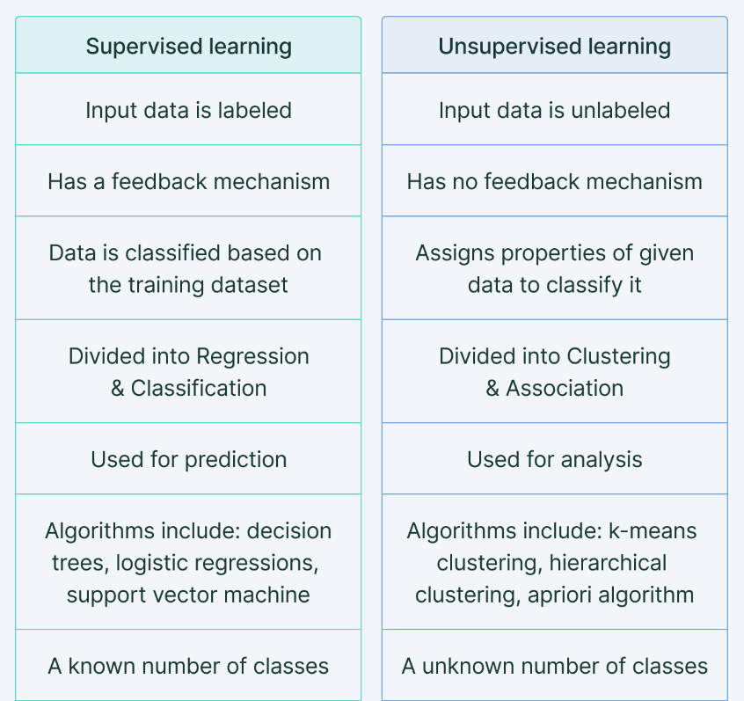
Lets recap

Slide 36
Let’s explore some other examples
Notes:
The final step of the machine learning process is prediction. This is the stage where we consider the model to be ready for practical applications. Our fruit model should now be able to answer the question whether the given fruit is an apple or an orange. The model gains independence from human interference and draws its own conclusion on the basis of its data sets and training. The challenge for the model remains whether it can outperform or at least match human judgment in different relevant scenarios.

Slide 37
Q.1 What is the best model for ML?
We need to predict the number of vehicle purchases in a city for historical data?
Would we need supervised vs unsupervised learning methods?

Slide 38
Q.2 What is the best model for ML?
We need to identify if a potential customer in that city would purchase a vehicle, given their income and community history
Would we need supervised vs unsupervised learning methods?

Slide 39
Q.3 What is the best model for ML?
We want to determine different segments of customers (i.e. gender, age, income bracket, education etc)
Would we need supervised vs unsupervised learning methods?

Slide 40
Round Off
The first half
What a ML is
Its’ functions
How ML works
How ML is different to classic stats
The second half
Different ML methods
Identified different models within each method
7 steps to Machine Learning

Slide 41
Any Questions…

Slide 42
References
Fucntions of machine learning: https://workofthefuture.mit.edu/wp-content/uploads/2020/12/2020-Research-Brief-Malone-Rus-Laubacher2.pdf
Machine Learning Alogrithims: https://ischoolonline.berkeley.edu/blog/what-is-machine-learning/
IBM: https://www.ibm.com/cloud/learn/machine-learning
Classificaiton vs regression image =: https://www.simplilearn.com/regression-vs-classification-in-machine-learning-article
Machine Learning vs Classic Stats: https://towardsdatascience.com/how-is-machine-learning-different-from-statistics-and-why-it-matters-5a8ed539976
Supervised vs unsupervised: https://www.v7labs.com/blog/supervised-vs-unsupervised-learning
7 Steps to Machine Learning: https://towardsdatascience.com/the-7-steps-of-machine-learning-2877d7e5548e

Slide 43
Material for Tuesday the 1st of November
GitHub:
https://github.com/UKDataServiceOpen/ML_Workshop

Slide 44
Thank You.
Email:
nadia.kennar@manchester.ac.uk,
louise.capener@Manchester.ac.uk
Twitter:
@NadiaKennar
@CapenerLouise

